Slide 1
Putting all layers together
A day in the life of an IP packet ☺

Slide 2
Synthesis: a day in the life of a web request
journey down protocol stack complete!
application, transport, network, link
putting-it-all-together: synthesis!
goal: identify, review, understand protocols (at all layers) involved in seemingly simple scenario: requesting www page
scenario: student attaches laptop to campus network, requests/receives www.google.com

Slide 3
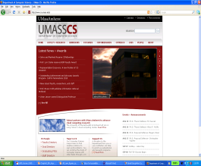

A day in the life: scenario
DNS Server is in another subnet
browser
DNS server
Switch
Comcast network
68.80.0.0/13
school network
68.80.2.0/24
web page
Router also is a DHCP Server
web server
Google’s network
64.233.160.0/19
64.233.169.105

Slide 4
A day in the life… connecting to the Internet
DHCP
DHCP
UDP
IP
Eth
Phy
connecting laptop needs to get its own IP address, addr of first-hop router, addr of DNS server: use DHCP
DHCP
DHCP
DHCP
DHCP
DHCP request encapsulated in UDP, encapsulated in IP, encapsulated in Ethernet
DHCP
DHCP
UDP
IP
Eth
Phy
DHCP
DHCP
DHCP
DHCP
router
(runs DHCP)
Ethernet frame broadcast (dest: FFFFFFFFFFFF) on LAN, received at router running DHCP server
Ethernet demux’ed to IP demux’ed, UDP demux’ed to DHCP

Slide 5
A day in the life… connecting to the Internet
DHCP
DHCP
UDP
IP
Eth
Phy
DHCP server formulates DHCP ACK containing client’s IP address, IP address of first-hop router for client, name & IP address of DNS server
DHCP
DHCP
DHCP
encapsulation at DHCP server, frame forwarded (switch learning) through LAN, demultiplexing at client
DHCP
DHCP
UDP
IP
Eth
Phy
DHCP
DHCP
DHCP
router
(runs DHCP)
DHCP client receives DHCP ACK reply
DHCP
Client now has IP address, knows name & addr of DNS
server, IP address of its first-hop router

Slide 6
A day in the life… ARP (before DNS, before HTTP)
DNS
UDP
IP
Eth
Phy
before sending HTTP request, need IP address of www.google.com: DNS
DNS
DNS
DNS
ARP
ARP query
DNS query created, encapsulated in UDP, encapsulated in IP, encasulated in Eth. In order to send frame to router, need MAC address of router interface: ARP
ARP
ARP reply
Eth
Phy
ARP query broadcast, received by router, which replies with ARP reply giving MAC address of router interface
client now knows MAC address of first hop router, so can now send frame containing DNS query

Slide 7
A day in the life… using DNS
DNS
UDP
IP
Eth
Phy
DNS
DNS server
DNS
UDP
IP
Eth
Phy
DNS
DNS
DNS
DNS
DNS
DNS
DNS
DNS
Comcast network
68.80.0.0/13
IP datagram forwarded from campus network into comcast network, routed (tables created by RIP, OSPF, IS-IS and/or BGP routing protocols) to DNS server
IP datagram containing DNS query forwarded via LAN switch from client to 1st hop router
demux’ed to DNS server
DNS server replies to client with IP address of www.google.com

Slide 8
A day in the life… TCP connection carrying HTTP
HTTP
HTTP
TCP
IP
Eth
Phy
SYNACK
SYN
SYNACK
SYN
SYNACK
SYN
SYN
to send HTTP request, client first opens TCP socket to web server
TCP SYN segment (step 1 in 3-way handshake) inter-domain routed to web server
TCP
IP
Eth
Phy
SYNACK
SYN
SYNACK
SYN
SYNACK
SYNACK
SYN
web server responds with TCP SYNACK (step 2 in 3-way handshake)
web server
64.233.169.105
TCP connection established!

Slide 9
A day in the life… HTTP request/reply
web page finally (!!!) displayed
HTTP
HTTP
TCP
IP
Eth
Phy
HTTP
HTTP
HTTP
HTTP
HTTP
HTTP
HTTP
HTTP
HTTP request sent into TCP socket
IP datagram containing HTTP request routed to www.google.com
HTTP
HTTP
TCP
IP
Eth
Phy
HTTP
HTTP
HTTP
web server responds with HTTP reply (containing web page)
HTTP
web server
64.233.169.105
IP datgram containing HTTP reply routed back to client

Slide 10
Putting all layers together
A day in the life of an IP packet ☺

Slide 11
What is going on now ☺
Ethernet 2018+
SDN+NFV
Networking for Cloud Computing

Slide 12
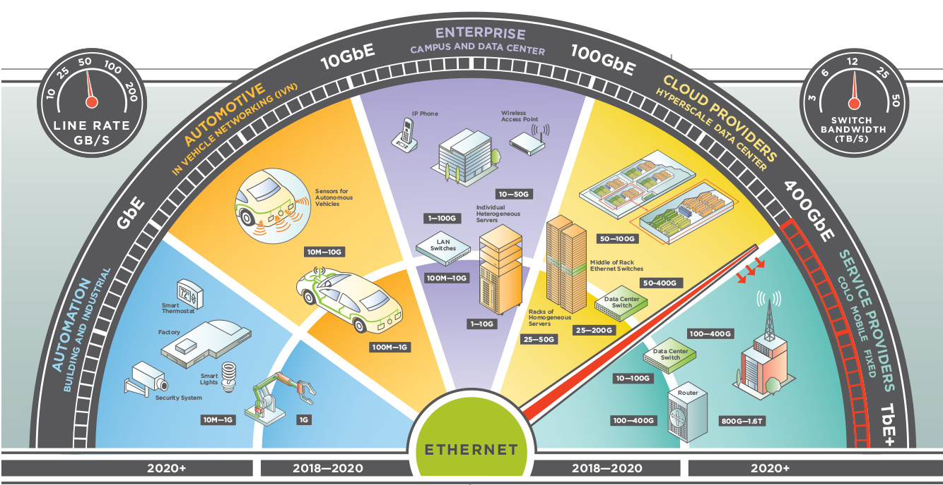
Ethernet 2018+
https://ethernetalliance.org/the-2018-ethernet-roadmap/

Slide 13
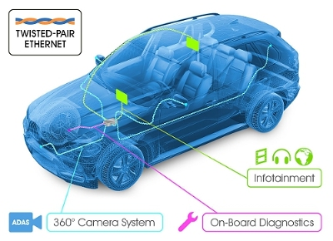
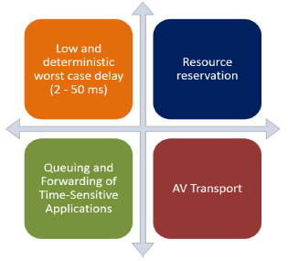
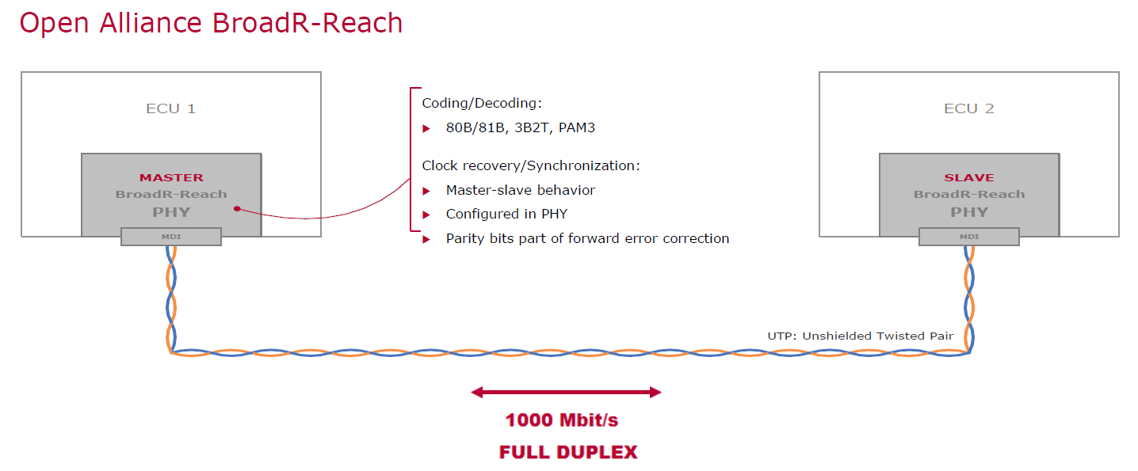
In-vehicle Ethernet
bandwidth requirements, latency requirements, synchronization, and network management
electrical requirements (EMI/RFI emissions and susceptibility)
Upper Layers
PHY Layer
IEEE 802.1AS
IEEE 802.1Q
IEEE 1722
Audio Video Bridging

Slide 14
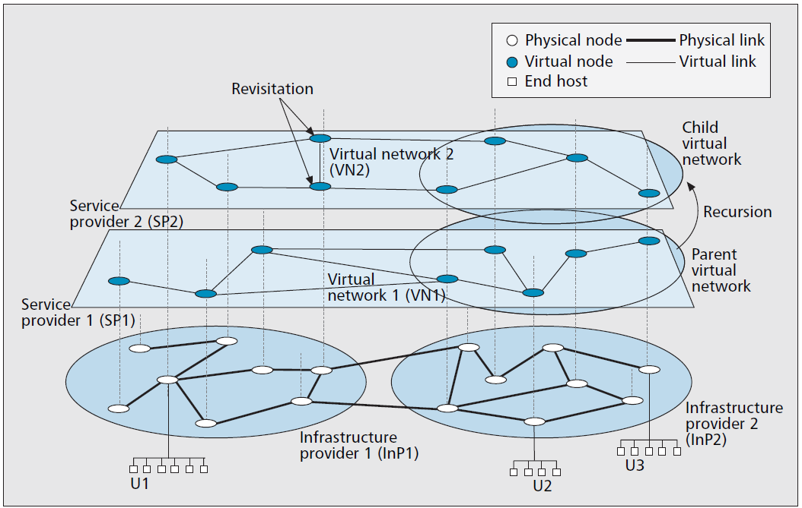
Network Virtualization
two independent entities:
infrastructure providers (InPs), who manage the physical infrastructure
service providers (SPs), who create virtual networks (VNs)
Each SP leases resources from one or more InPs to create VNs
Deploys customized protocols and services.

Slide 15





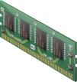

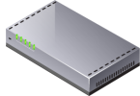


Virtualization =Abstraction + Pooling = Reduced Complexity
Traditional View
Virtual Infrastructure
Exchange
File/Print
OS
OS
Virtual Infrastructure
Operating System
Operating System
Virtualization
Virtualization
CPU Pool
Memory Pool
SAP ERP
Oracle CRM
OS
OS
Storage Pool
Operating System
Operating System
Virtualization
Virtualization
Interconnect Pool

Slide 16
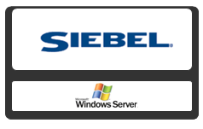


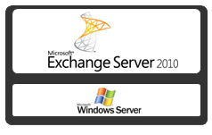
Virtualization =Abstraction + Pooling = Reduced Complexity
Exchange
File/Print
Operating System
Operating System
Virtual Infrastructure
CPU Pool
Memory Pool
SAP ERP
Oracle CRM
Storage Pool
Operating System
Operating System
Interconnect Pool

Slide 17
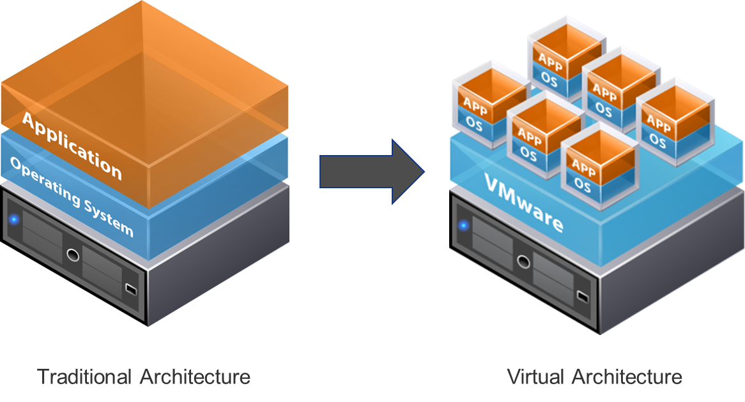
Virtualization Enabler: Hypervisor
Hypervisor: A program
synthesizes virtual computing environments
virtual NIC, BIOS, sound adapter, and video
Shares real resources between the virtual machines.
Entire state of the virtual machine can be saved to files
Move and copy virtual machines as easily as moving and copying files
https://www.vmware.com/

Slide 18
Software Defined Networking
What we know:
Distributed control plane
Distributed routing protocols: OSPF, IS-IS, BGP, etc.
Feature
Feature
Operating
System
Feature
Feature
Specialized Packet Forwarding Hardware
Operating
System
Feature
Feature
Specialized Packet Forwarding Hardware
Operating
System
Feature
Feature
Specialized Packet Forwarding Hardware
Operating
System
Feature
Feature
Specialized Packet Forwarding Hardware
Operating
System
Specialized Packet Forwarding Hardware

Slide 19
Software Defined Networking
What we know:
Distributed control plane
Distributed routing protocols: OSPF, IS-IS, BGP, etc.
Feature
Feature
Operating
System
Feature
Feature
Specialized Packet Forwarding Hardware
Operating
System
Feature
Feature
Specialized Packet Forwarding Hardware
Operating
System
Feature
Feature
Specialized Packet Forwarding Hardware
Operating
System
Feature
Feature
Specialized Packet Forwarding Hardware
Operating
System
Specialized Packet Forwarding Hardware

Slide 20
From Vertically Integrated to …
Feature
Feature
Network OS
Feature
Feature
Operating
System
Feature
Feature
Specialized Packet Forwarding Hardware
Operating
System
Feature
Feature
Specialized Packet Forwarding Hardware
Operating
System
Feature
Feature
Specialized Packet Forwarding Hardware
Operating
System
Feature
Feature
Specialized Packet Forwarding Hardware
Operating
System
Specialized Packet Forwarding Hardware
Notes:
This is the vision of SDN.
Seperation of the data plane from the control plane.
We build a network operating system that controls the forwarding elements through an open protocol and on top of which we can implement different features, like routing, etc.
Put the control plane into software running on a server.
To add a new capability you write a new feature on top.

Slide 21
Software Defined Network
Well-defined open API
Constructs a logical map of the network
Feature
Feature
Network OS
Open vendor agnostic protocol
OpenFlow
Simple Packet
Forwarding
Hardware
Simple Packet
Forwarding
Hardware
Simple Packet
Forwarding
Hardware
Simple Packet
Forwarding
Hardware
Simple Packet
Forwarding
Hardware

Slide 22
OpenFlow Basics
Control Program A
Control Program B
Network OS
“If header = p, send to port 4”
“If header = q, overwrite header with r, add header s, and send to ports 5,6”
“If header = ?, send to me”
Primitives <Match, Action>
Packet
Forwarding
Flow
Table(s)
Packet
Forwarding
Packet
Forwarding

Slide 23
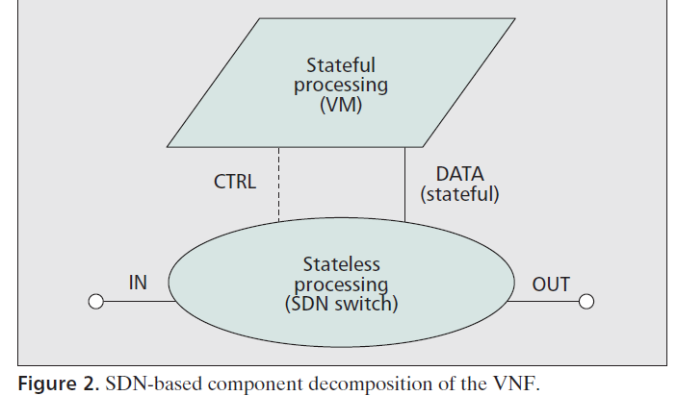
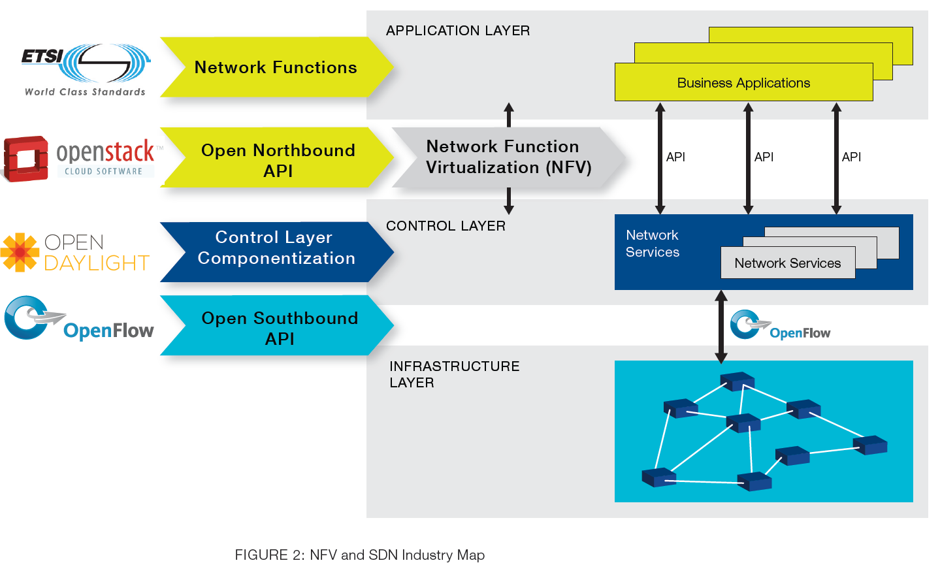
New Network Architecture
SDN+Network Function Virtualization (NFV)

Slide 24
Evolving to Cloud Computing
Network operators began to realize that computing power demand in general increased over time.
IT departments (which typically budget on a yearly basis) would order all the equipment they predicted would be needed for the following year.
However, once this equipment arrived and was placed in racks, it would consume power, cooling, and space resources—even if it was not yet used!
Case study: Amazon Web Services (AWS)

Slide 25
Objectives and Characteristics
Elasticity: Ability to scale virtual machines resources up or down
Resource Pooling
Location Independence
On-demand usage: Ability to add or delete computing power (CPU, memory), and storage according to demand
Self-service
Pay-per-use: Pay only for what you use.
Measured Service
Multitenancy: Ability to have multiple customers access their servers in the data center in an isolated manner
Broad network access

Slide 26
Network Requirements
Be fully automated & programmable for integration into Cloud Management Platforms
(on-demand self-service)
Be abstracted from hardware in order to pool available capacity
(resource pooling)
Support programmability and integration with orchestration/ provisioning solutions (rapid elasticity)
Provide fine-grained visibility & accounting (measured service)
Support any network topology & any network equipment (broad
network access)

Slide 27
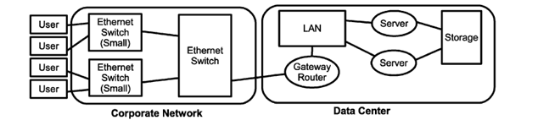
Network Requirements
Virtual switch at the edge of the network
Centralized control over/knowledge of the logical network topology
Decoupled control plane and data plane
Network isolation mechanism
Virtualized network services (L2, L3, load balancer, firewall)
Programmatic access for integration with Cloud Management Platform

Slide 28
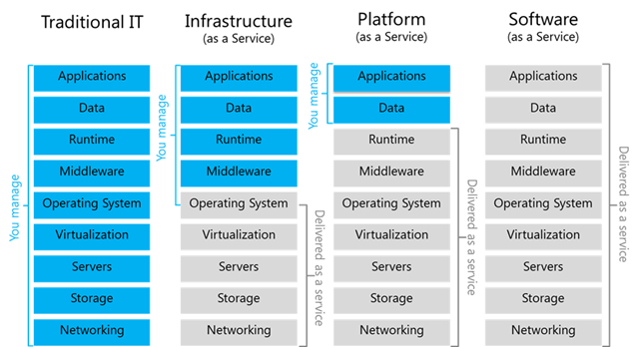
Cloud Services

Slide 29
What is going on now ☺
Ethernet 2018+
SDN+NFV
Networking for Cloud Computing

